Slide 1
Twitter Sentiment Analysis with Stock Price and Significant Keyword Correlation
Linhao Zhang
Advisor: Inderjit Dhillon

Slide 2



Slide 3
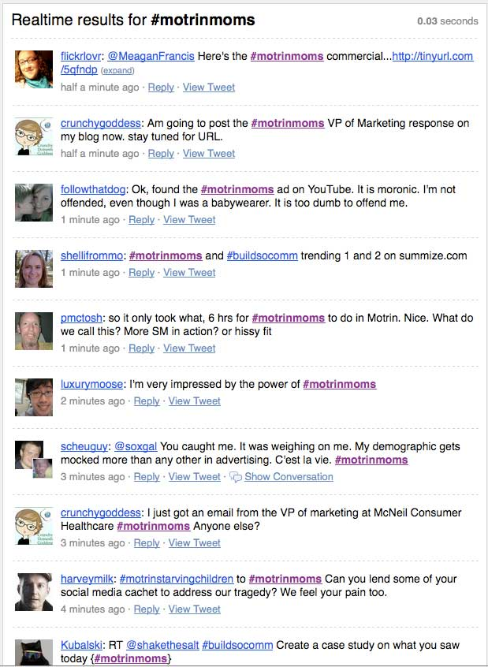
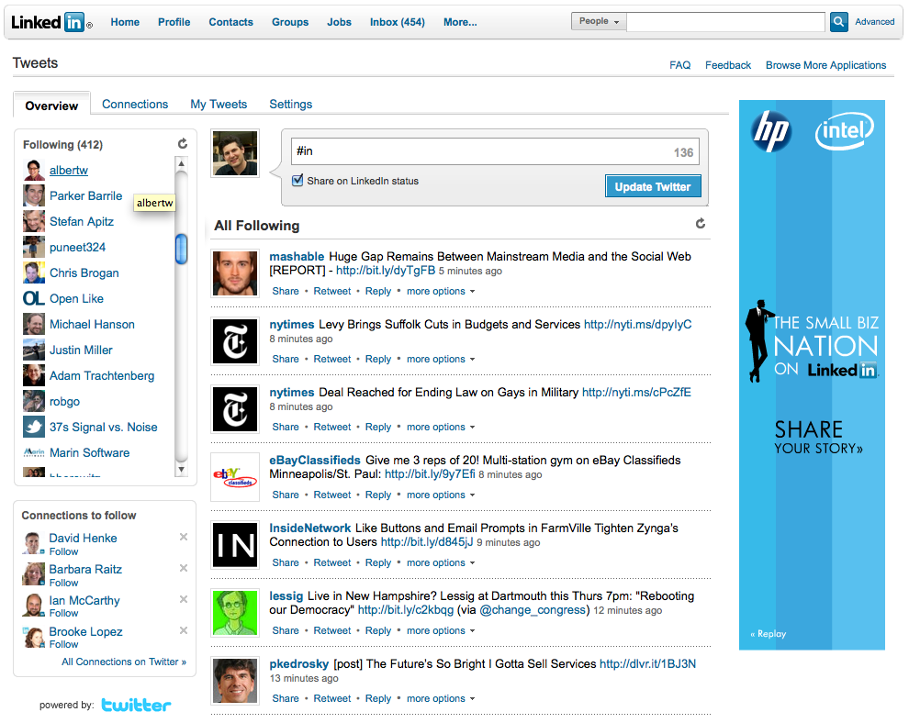

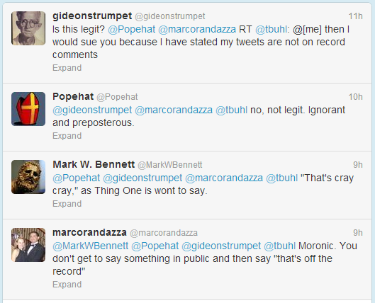

Slide 4
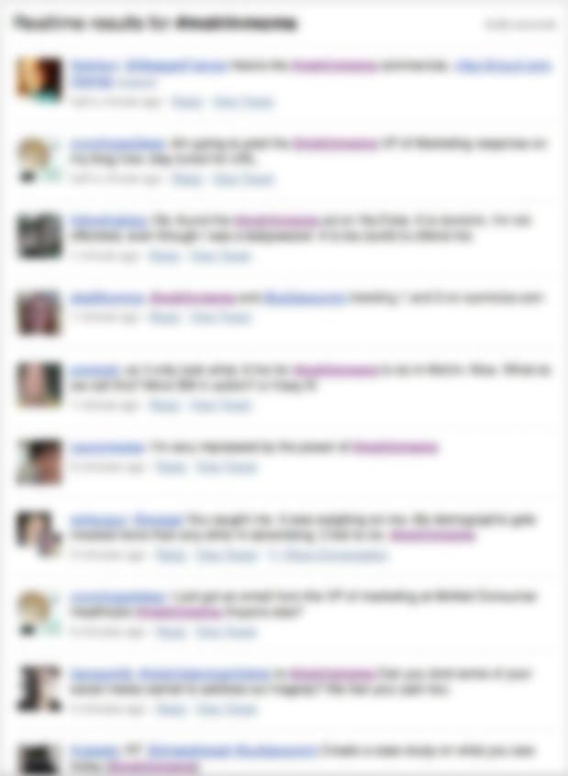

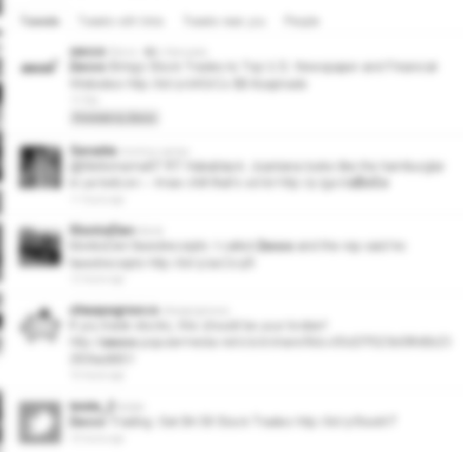
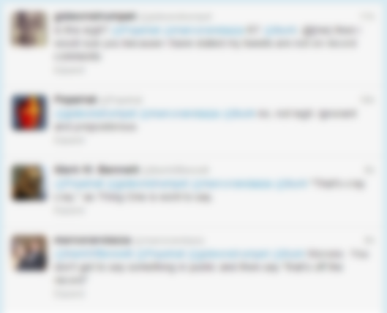
=( or =)

Slide 5
3 parts to project

Slide 6
Primary Goal: Investigate and analyze three machine learning techniques for classifying tweets by sentiment.

Slide 7
Secondary Goal: Correlate twitter sentiment with intra-day stock prices

Slide 8
Secondary Goal: Significant Keyword Discovery: Look for Twitter keywords that are correlated with stock price change

Slide 9
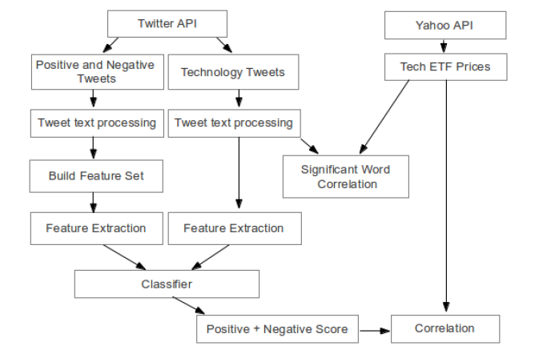
Proposed Model

Slide 10
Proposed Model

Slide 11
Proposed Model

Slide 12
Proposed Model

Slide 13
Primary Goal: Investigate and analyze three machine learning techniques for classifying tweets by sentiment.

Slide 14
Building a training set

Slide 15
Training Set
Wanted to automate tweet collection
Manually tagging tweets too time consuming and unreliable
Needed a way to automatically label many tweets positive or negative.
Twitter provides a simple API

Slide 16
Twitter API
Streaming API
Search API
JSON results
Limited access to Twitter’s global stream of data
No language or geo control
“Gardenhose” vs. “Firehose”
JSON results
REST API
HTTP GET
Detailed query control, including language and geo
Rate limited

Slide 17
Twitter API
Streaming API
Search API
JSON results
Limited access to Twitter’s global stream of data
No language or geo control
“Gardenhose” vs. “Firehose”
JSON results
REST API
HTTP GET
Detailed query control, including language and geo
Rate limited

Slide 18
Training Set Collection
Positive Sentiment Query:
“:) OR :-) OR =) OR <3 OR like OR love”
Negative Sentiment Query:
“:( OR :-( OR =( OR dislike OR hate”

Slide 19

MongoDB
Open source, document based database
Data is stored in collections, as JSON-like objects.
Well formatted for storing tweet data

Slide 20
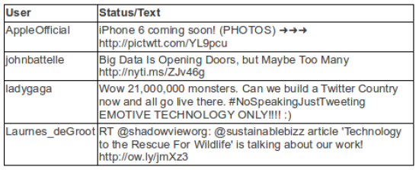
Text Tweet Preprocessing

Slide 21
Tokenization
Stopword Removal
Symbol Removal

Slide 22
Tokenization
Stopword Removal
Symbol Removal

Slide 23
Tokenization
Stopword Removal
Symbol Removal

Slide 24
Training the Classifiers

Slide 25
Feature Extraction
Feature: measurable heuristic property of class
Vectors of features used as input into training classifiers
Features we used were all binary, either true or false

Slide 26
External Lexicon
Unigrams, Bigrams, Trigrams
Part of Speech Tagging

Slide 27
External Lexicon
Precompiled list of positive and negative words
Many widely available on the web
Not practical in our situation, as most of the words aren’t used in the “twitter vocabulary.”

Slide 28
Unigrams, Bigrams, and Trigrams
Single words
Pairs of words
Triplets of words
As features, they are either true or false- the N-gram exists or doesn’t

Slide 29
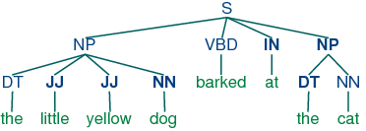
Part of Speech Tagging
Label each word in a sentence with a part of speech
Not practical for Tweets, as many of them are not real sentences

Slide 30
External Lexicon
Unigrams, Bigrams, Trigrams
Part of Speech Tagging

Slide 31
Reducing Feature Count

Slide 32
Reducing Feature Count
With Unigrams, Bigrams, and Trigrams, feature count would be 3n, where n is the number of total unique words
Inefficient, many words add no information
Instead, use only the most important features.
In our case, determine which N-grams are most relevant to tweet classification

Slide 33
Chi-Squared Test
TF-IDF

Slide 34
Chi-Squared Test
Used as a substitute measure of information gain
Tests statistical significance of features, or more specifically, whether or not a measured frequency distribution differs from the theoretical distribution
In our case, measures the significance of unigrams, bigrams, and trigrams to the tweet corpus
Specifically, Pearson’s Chi-square test

Slide 35
Chi-Squared Test
For each unique N-gram in all tweets, calculate Chi-squared score
Sum up scores for each N-gram
Higher scores mean more relevant N-gram in tweet context
Finally: take top 10,000 scored N-grams and use them as features

Slide 36
TF-IDF Scoring
TF-IDF = Term Frequency x Inverse Document Frequency
Term Frequency: Number of times a term occurs in a tweet
Inverse Document Frequency: Inverse of frequency of tweets that contain term

Slide 37
TF-IDF Scoring
For each unique N-gram in all tweets, calculate TF-IDF score
Sum up TF-IDF scores for each N-gram
Higher scores mean more relevant N-gram in tweet context
Finally: take top 10,000 scored N-grams and use them as features

Slide 38
The Three Classifiers

Slide 39
1. Naïve Bayes Classifier
2. Maximum Entropy Classifier
3. Support Vector Machine

Slide 40
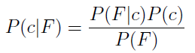
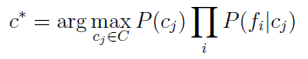
Naïve Bayes
A probabilistic classifier based on Bayes Rule:
Looking for a probable class, c, given features F.
P(F) treated as a constant
“Naïve” assumption: Given a class, c, the features are conditionally independent of each other.
Classify a tweet with a label, c*, that is the most probable from all labels C:

Slide 41
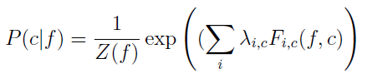
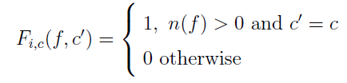
Maximum Entropy
Removes independence assumptions between features.
Each feature corresponds to a constraint on the model.
Computes the maximum entropy value from all models that satisfy feature constraints:
Z(f) is a normalization function, and F is a binary function that takes as input a feature and class label:

Slide 42
Maximum Entropy
The binary function F is triggered when a certain feature exists and the sentiment is hypothesized a certain direction
λ is a vector of weight parameters for the feature set, estimated through an iterative technique called MegaM.
MegaM: Implementation of a conjugate gradient ascent method to train maximum entropy models (Daume, 2007)
Iterative method- iteratively updates the values of the weight parameters that satisfy the feature constraints while maximizing the entropy of the model
We use a max of 10 iterations

Slide 43
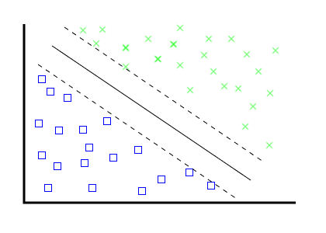
Support Vector Machine
A large margin classifier- attempts to find the maximum linear separation between classes of data
“Support vectors” are hyperplanes that come from points on margin between hyperplane and nearest data points:

Slide 44
Classifier Evaluation Results

Slide 45
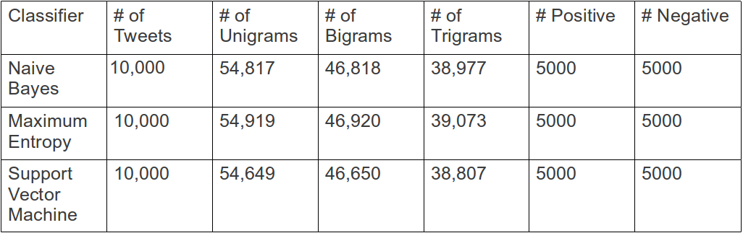
Training Datasets

Slide 46
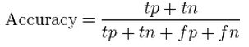
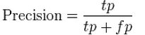
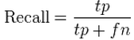
Classifier Evaluation Metrics
Accuracy: Percentage of tweets correctly classified
Precision: Correctly labeled sentiment over all tweets which are labeled that sentiment
Recall: Correctly labeled sentiment over all tweets which are truly that sentiment

Slide 47
Classifier Evaluation Metrics
K – fold cross validation:
Split dataset into k equally sized subsets
One set is set apart as a test set
k -1 other sets used as training set
Repeated k times, with a different set set apart each time
Average accuracies, precisions, and recalls reported

Slide 48
Naïve Bayes
Chi Squared Features
TF-IDF Features
4-fold cross validation
Accuracy: 0.8373
Positive Precision: 0.7419
Positive Recall: 0.9912
Negative Precision: 0.9874
Negative Recall: 0.6667
4-fold cross validation
Accuracy: 0.8613
Positive Precision: 0.7260
Positive Recall: 0.9953
Negative Precision: 0.9965
Negative Recall: 0.7842

Slide 49
Maximum Entropy
Chi Squared Features
TF-IDF Features
4-fold cross validation
Accuracy: 0.8359
Positive Precision: 0.7520
Positive Recall: 0.9963
Negative Precision: 0.9947
Negative Recall: 0.6772
4-fold cross validation
Accuracy: 0.8313
Positive Precision: 0.7408
Positive Recall: 0.9882
Negative Precision: 0.9813
Negative Recall: 0.6423

Slide 50
Support Vector Machine
Chi Squared Features
TF-IDF Features
4-fold cross validation
Accuracy: 0.8375
Positive Precision: 0.9974
Positive Recall: 0.6753
Negative Precision: 0.7545
Negative Recall: 0.9983
4-fold cross validation
Accuracy: 0.8729
Positive Precision: 0.9891
Positive Recall: 0.7766
Negative Precision: 0.7294
Negative Recall: 0.9859

Slide 51
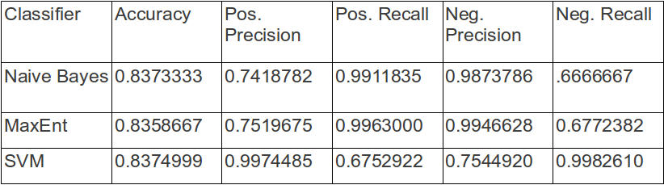
Results Summary – Chi Squared Test

Slide 52
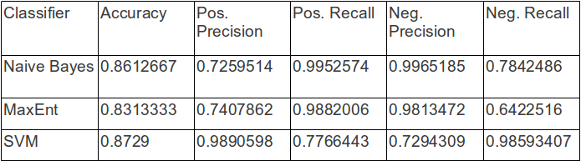
Results Summary – TF-IDF

Slide 53
Results Discussion
All techniques achieved better than 50% baseline classification, as expected
SVM had the highest accuracy, then Naïve Bayes, then Maximum Entropy
TF-IDF scoring performed better than Chi-squared test for best feature selection by a significant margin, except for Maximum Entropy

Slide 54
Results Discussion
Positive precision and negative recall rates were lower for Naïve Bayes and Maximum Entropy Classifiers
Positive recall and Negative precision rates lower for SVM
SVM tended to label things more negatively, and Naïve Bayes and Maximum Entropy more positively.

Slide 55
SVM + TF-IDF feature reduction

Slide 56
Neutral Label
Decided against using a ‘neutral’ label
Difficult to build a ‘neutral’ set of training tweets, automatically
In future, could consider scoring tweets on a scale rather than a assigning a sentiment polarity

Slide 57
Secondary Goal: Correlate twitter sentiment with intra-day stock prices

Slide 58
Exchange Traded Fund
Investment funds traded on stock exchanges, like stocks
Commonly follow an index of stocks
Tracked 25 of the highest traded technology related ETFs
Assumed to be a good representation of the technology industry

Slide 59
ETF List
XLK, VGT, IYW, FDN, IGV, IXN, IGM, IGN, SMH, SOXX, FXL, MTK, TECL, QTEC, PSCT, RYT, SKYY, SOXL, ROM, TDIV, RNQI, XSD, PSJ, SOXS, USD

Slide 60
Stock Mining
Used Yahoo Finance REST API
Collected minute by minute stock price data on ETFs
Collected data only during market hours:
8:30 AM – 3:00 PM (CST)
Stored data in MongoDB, with timestamp

Slide 61
Tweet Mining
Similar to training data collection, used Twitter Search API
Search Query:
“Technology OR Stocks”
Collected data only during market hours:
8:30 AM – 3:00 PM (CST)
Stored data in MongoDB, with timestamp

Slide 62
Methods
Associate each tweet and each stock price with a timestamp, to the closest minute, m
For each minute, m, compute sentiment score
Normalize both sentiment score and stock price
Choose a set of lag values, l, to iterate through.
For each lag value, compute correlation between sentiment score and stock price

Slide 63
Lag Value
Tweet score and stock price time series were lagged by a certain value to account for any effect time difference
Yahoo stock prices inherently lagged 15 minutes
Allows us to search for lag values with the highest correlation
Iterated through various lag values:
0, 10, 20, 30, 40, 50, 60, 70, 80, 90 minutes

Slide 64
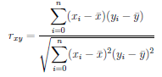
Correlation
Pearson Correlation:

Slide 65
Intra-day Correlation Results
For all ETFs tested, almost no correlation between tweet sentiment and stock price
No Pearson correlation values for any lag exceeded 0.1.
High volatility in stock sentiment scores, but little change in stock price over the course of a day

Slide 66
Discussion
Results were not surprising, as effective capturing of twitter sentiment requires larger time granularities.
Not enough variance in ETF price throughout a day- instead, need to look at a longer time scale, over months or years.
Need more tweets per minute to compute a better score at a small granularity, but rate limited

Slide 67
Secondary Goal: Significant Keyword Discovery: Look for Twitter keywords that are correlated with stock price change

Slide 68
Significant Keyword Correlation
With stock data and tweet texts, we can associate words with stock price changes to discover information
Useful to discover which keywords in tweets are most correlated with stock price increases and decreases.
After-the-fact information useful for future studies
Used same lag values as correlation
0, 10, 20, 30, 40, 50, 60, 70, 80, 90 minutes

Slide 69
Methods
Associate each tweet and each stock price with a timestamp, to the closest minute
Choose a set of lag values, l, to iterate through
Initialize a dictionary which will map individual word scores to a score for every minute, m.
For each minute m, compute the difference, d, between the current stock price and the stock price after a certain lag.
Add d to each word per tweet at minute m.
Return the words with highest and lowest total scores.

Slide 70
Results
We were able to extract meaningful information that indicate why stock prices increased or decreased.
Even on an intra-day scale, we were able to find information about events and news during the day.
However, not all days seemed to have tweet correlated stock price changes.

Slide 71
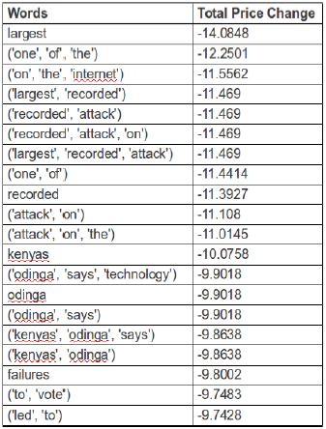

Slide 72
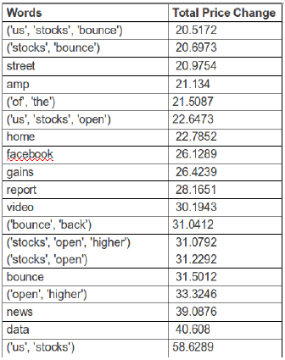

Slide 73
Discussion
Shows that there is, on some days, some sort of correlation between tweet words and stock prices, if not sentiment, on an intra-day level.
Across all days, keywords correlated with price decreases seemed most relevant. This leads us to hypothesis that people use twitter more for negative events or news that lead to price decreases.
Positive price change keywords were less consistent, and at times included words that were related to stocks in general.

Slide 74
Project Model

Slide 75
Project Challenges and Limitations
Query formation
Negation words – ‘don’t like’
Neutral Tweets
Slang
Size of Dataset / Time of Collection
Computational Power

Slide 76
Future Work
Expand Sentiment Analysis to include ‘neutral’ tweets
Expand stock correlation portion over a larger time scale, and make price movement predictions
Use significant keywords analysis in real time to signal stock price change on a larger scale

Slide 77
Acknowledgements
Dr. Inderjit Dhillon - advisor
Dr. Adnan Aziz - second reader
Dr. William Press - thesis external committee

Slide 78
Code
github.com/lintaho

Slide 79
References
Elson, S., Yeung, D., Parisa, R., Bohandy, S. . R., and Nader, A. (n.d.). Using social media to gauge iranian public opinion and mood after the 2009 election. (2012). RAND.
B. Pang, L. Lee, and S. Vaithyanathan. Thumbs up? Sentiment Classification using Machine Learning Techniques. Proceedings of EMNLP Publication. 79-86: Cornell, 2002.
J. Bollen and H. Mao. Twitter mood as a stock market predictor. IEEE Computer, 44(10):91–94.
Alexander Pak and Patrick Paroubek. Twitter as a Corpus for Sentiment Analysis and Opinion Mining. In Proceedings of LREC. (2010).
Mittal, Anshul, and Arpit Goel. Stock Prediction Using Twitter Sentiment Analysis. Publication. N.p.: Stanford, n.d. Print.
SentiWordNet. An Enhanced Lexical Resource for Sentiment Analysis and Opinion Mining. http://sentiwordnet.isti.cnr.it/
Chen, Ray, and Marius Lazer. Sentiment Analysis of Twitter Feeds for the Prediction of Stock Market Movement. Publication. Stanford, 2011. Print.
Baccianella, Stefano, Andrea Esuli, and Fabrizio Sebastiani. SentiWordNet 3.0: An Enhanced Lexical Resource for Sentiment Analysis and Opinion Mining. Publication. N.p.: Istituto Di Scienza E Tecnologie Dell'Informazione, 2010. Print.
Bifet, Albert, and Eibe Frank. Sentiment Knowledge Discovery in Twitter Streaming Data. Publication. Hamilton: University of Waikato, n.d. Print.
Hurwitz, E., and T. Marwala. Common Mistakes When Applying Computational Intelligence and Machine Learning to Stock Market Modelling. Publication. N.p.: Cornell, 2012. Print.
Brown, Eric D., ``Will Twitter Make You a Better Investor? A Look at Sentiment, User Reputation and Their Effect on the Stock Market'' (2012). SAIS 2012 Proceedings. Paper 7.http://aisel.aisnet.org/sais2012/
Shangkun Deng, Takashi Mitsubuchi, Kei Shioda, Tatsuro Shimada, and Akito Sakurai. 2011. Combining Technical Analysis with Sentiment Analysis for Stock Price Prediction. In Proceedings of the 2011 IEEE Ninth International Conference on Dependable, Autonomic and Secure Computing (DASC '11). IEEE Computer Society, Washington, DC, USA, 800-807. DOI=10.1109/DASC.2011.138 http://dx.doi.org/10.1109/DASC.2011.138
Zhang, DongSong, and Lina Zhou. Discovering Golden Nuggets: Data Mining in Financial Application. Systems, Man, and Cybernetics, Part C: Applications and Reviews, IEEE Transactions on 34.4 (2004): 513-22. Web.
Daum, Hal. ``Notes on CG and LM-BFGS Optimization of Logistic Regression''. Paper available at http://pub.hal3.name#daume04cg-bfgs (2004).
Bromberg, A. (14, February 2013). \it Second try: Sentiment analysis in python. Retrieved from http://andybromberg.com/sentiment-analysis-python/

Slide 80
Questions?

